Slide 1


ABAP on Hana s/4 Hana Training
Day 7
contact@anubhavtrainings.com

Slide 2

Agenda – Day 7
Creation and execution of Data Models
Showing Concept of currency conversion
Concept of Dimensions and Measures
Implementing OIA Using Calculation View
Concept of Delivery Unit

Slide 3
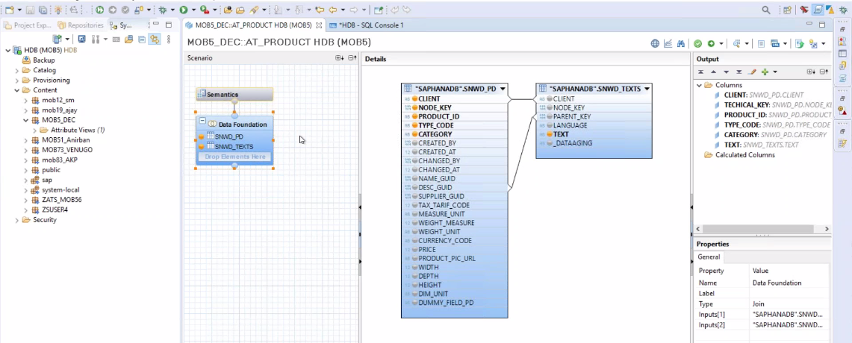
Attribute View
Attribute views provide descriptive data about the characteristics of data in your database. This is “master data” that defines things like hierarchies that describe relationships between data elements. By constructing attribute views, you create dimensions from which subsequent views can be constructed.

Slide 4
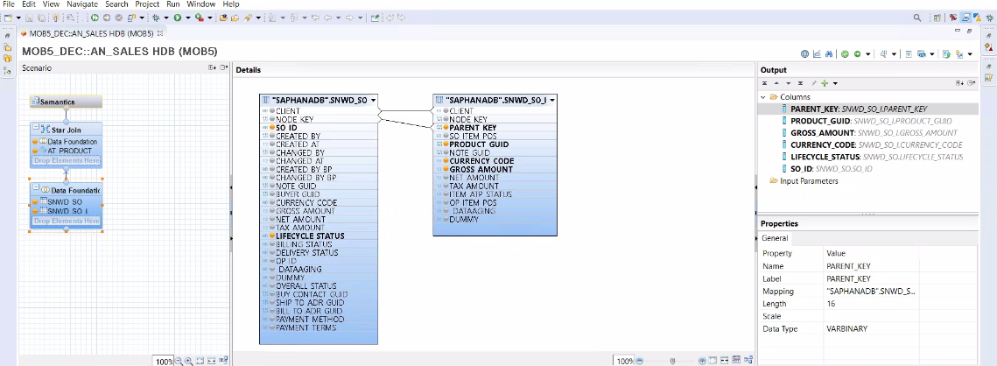
Analytic View
Analytic views in SAP HANA are optimized for aggregating mass data. Because the database is so fast, it’s not necessary to store aggregates in the database; rather, you aggregate on the fly in memory. Analytic views construct a central master “fact table” with key figures. You can use expressions, operators, and functions to analyze this data.

Slide 5
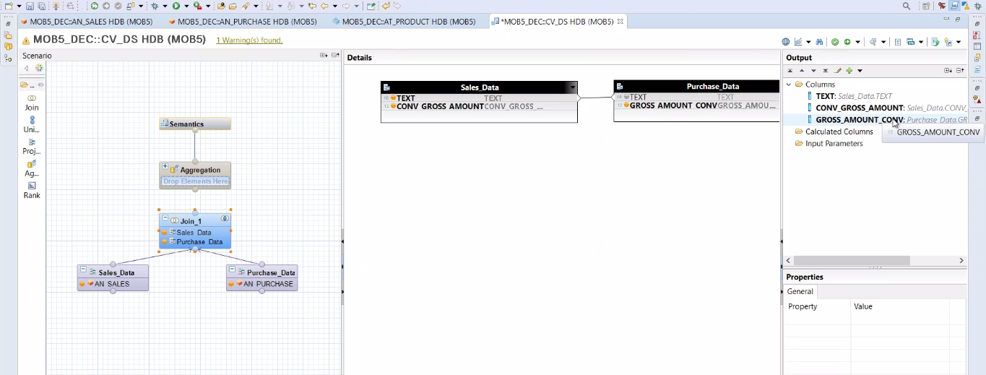
Calculation View
Calculation views provide a way to do flexible, complex logic in the database. They are built on top of one or more analytic or attribute views and allow you to do calculations after aggregation and grouping. Calculations are generally done after grouping at the attribute level and after aggregation at the analytic level.

Slide 6

OIA Scenario Using Calculation View
Mr. James told about me to the CIO of the company last week on Christmas dinner. The CIO is very impressed by listening my stories how I helped Mr. James. Now he want me to help him as well.
He called me for a 1:1 meeting this morning. He was a secret task by the CEO of the co. Since quite a long time there were multiple escalations going on in co. for unpaid bills to their vendors and also customers who are unhappy due to unavailability of stocks.

Slide 7
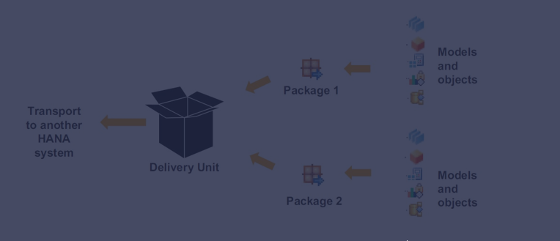
Concept of Delivery Unit
Delivery units are SAP HANA specific packages that can be used to install content, transport data models and applications developed on the SAP HANA platform. The delivery unit management window can be accessed through the 'Modeler Perspective' in SAP HANA Studio.

Slide 8

End of Day 7
Trainer: Anubhav Oberoy

Slide 9

Trainer: Anubhav Oberoy

Slide 10
THANK YOU
If you cannot do
great things, do small things in a great way.
Anubhav Oberoy
https://www.anubhavtrainings.com

Slide 11


We’re committed to empower you to be
Most Desirable Resource
through powerful training solutions.
We build the workforce of the future.
250+
Corporate Clients
30,000+
Learners Trained
25000+
Learners Placed
FREE WEBINARS
Sign up for free webinars with industry experts every fortnight!
Enroll Now!
Contact us today!
https://anubhavtrainings.com/

Slide 12




More from AnubhavTrainings.com

